Slide 1
Lab3 Questions
Yao Zhao

Slide 2
Lab3.A: LRU Cache
You need to implement a Least Recently Used (LRU) Cache that supports the following operations efficiently:
get key - Print the value of the key if the key exists, otherwise print -1.
put key value - Update the value of the key if the key exists. Otherwise, add the key-value pair to the cache. If the cache exceeds its capacity after this operation, evict the least recently used key.
Both operations must run in O(1) average time complexity.
The cache should be implemented without using LinkedHashMap in Java.

Slide 3
Initial：
Sample Input
put 1 2：
1:1
2 9
put 1 1
put 2 2
get 1
put 3 3
get 2
put 4 4
get 1
get 3
get 4
2:2
1:1
put 2 2：
get 1 ：
1:1
2:2
evicted
1
put 3 3：
3:3
1:1
2:2
get 2：
-1
put 4 4：
4:4
3:3
Sample Output
get 1 ：
-1
1
-1
-1
3
4
get 3 ：
3:3
4:4
3
get 4 ：
4:4
3:3
4

Slide 4
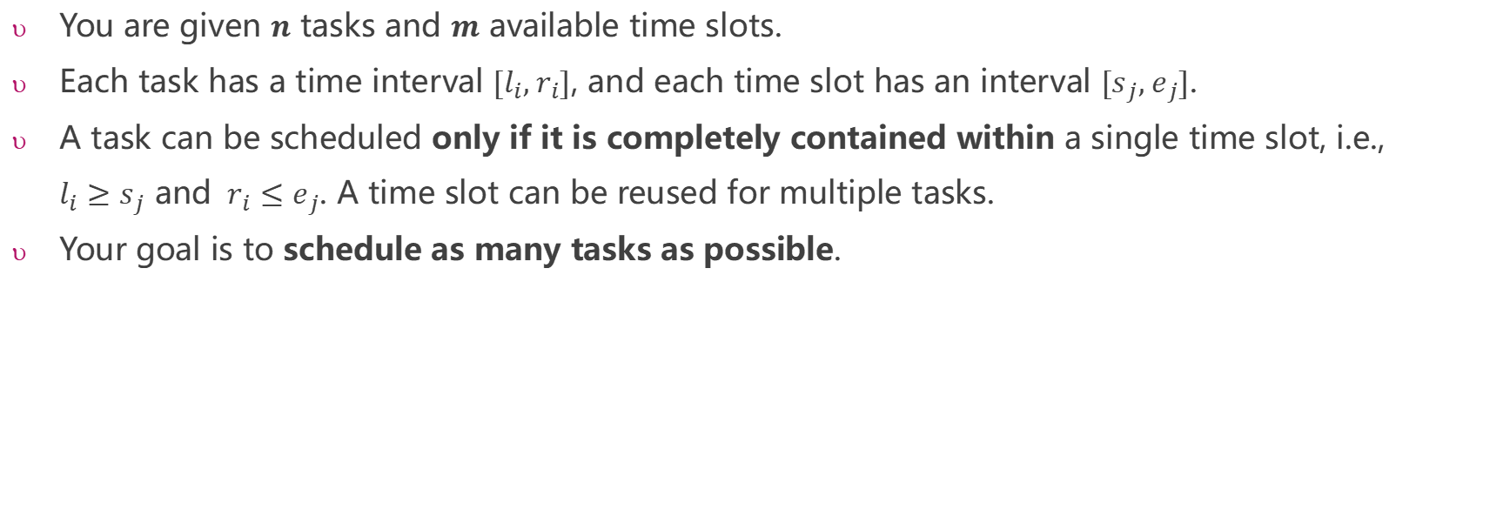
Lab3.B: Task Scheduler
You are given $n$ tasks and $m$ available time slots.
Each task has a time interval $[l_{i}, r_{i}]$, and each time slot has an interval $[s_{j}, e_{j}]$.
A task can be scheduled only if it is completely contained within a single time slot, i.e.,
$l_{i}≥s_{j}$ and $r_{i}≤e_{j}$. A time slot can be reused for multiple tasks.
Your goal is to schedule as many tasks as possible.

Slide 5
Sample Input
5 3
1 3
2 5
6 8
7 9
10 11
1 4
5 7
6 12
tasks
Sample Output
4
time slots
1
2
3
4
5
6
7
8
9
10
11
12

